Slide 1
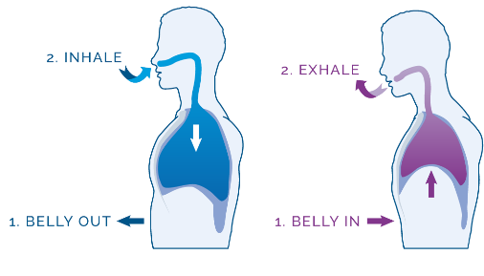
Stress Management for Health Professionals
Health emergencies inevitably have an emotional impact on us. These are normal reactions to abnormal situations. In the same way you look after yourself by using a mask or gloves, you can look after your emotional health at these difficult times.
What is my current stress level?
Anxiety can manifest with emotional, behavioural and physical symptoms. It is important to detect those symptoms.
Emotional
Feeling ill at ease and anxious and sad, difficulties concentrating, irritability and getting angry more quickly than usual, fear of not being able to meet targets, feeling like crying, hopelessness.
Physical
Tiredness, sleepiness, headaches, abdominal pain, diarrhoea, back ache.
Behavioural
Apathy, getting into arguments, avoiding contact with others, hyperactivity, increased consumption of coffee/alcohol/drugs, self neglect.
Symptom monitoring
10- High stress, at risk of physical and emotional symptoms
5-Moderate stress, building up
0-Low stress, feeling fine
Consider other factors other than Covid-19, that could be contributing to your stress, and what stress level you had before (financial worries, interpersonal relationships, health …)
What can I do?
Stop momentarily and bring your attention to the here and now
Take 3 slow and deep breaths
Observe and label 3 sounds around you.
Proceed with whatever you need to do
And Breathe…
Inhale slowly and deeply
Other things that might help
-Reduce your intake of coffee, tea, and other stimulants
-Eat, rest and exercise regularly
-Share your experience with others, talk about it (but not too much !)
-Praise and supporting each other at work
-Look for little moments to stop and relax
-Think about strategies that have been helpful at other difficult times in your life
- Try to be strict and away from work when you are not there
Feel your ribs expanding
Feel your belly expanding
Breath out slowly and feel your belly draw in

